Slide 1
Non-Verbal Communication
‘We speak with our vocal organs, but we converse with our whole body’. (Abercrombie, 1968: 55)

Slide 2
Haptics (Touching)
It is a form of non-verbal communication using a sense of touch
The sense of touch allows one to experience different sensations
Touching is our first non-verbal experience in life. Through touch we learn to relate to people and objects
It can be divided into touching oneself and touching others
Self-touching can indicate how a person is feeling (not necessarily communicative)
Most communicative touching involves touching others
It can be hostile (kicking) but mostly used to indicate the degree of intimacy

Slide 3
Types
Functional/professional
Social/polite
Friendship/warmth
Love/Intimacy

Slide 4

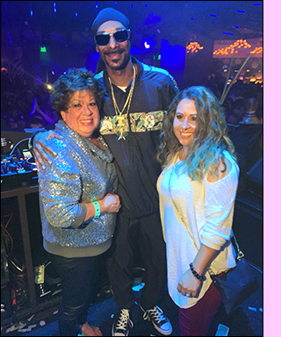



Slide 5
Positive Touch & Negative Touch
Positive Touch: Affectionate and loving touch can lead to positive outcomes (our physical and psychological well being)
Examples: Hugging, caressing, kissing
Negative Touch: Condescending and violent touch can lead to negative outcomes such as lowered self esteem, stress, and illness
Examples: Hitting, biting, kicking, forceful kissing or hugging (sexual harassment)

Slide 6
Cultural Variations
Physical contacts vary across cultures
High-contact cultures and Low-contact cultures
Asia and quite surprisingly the United States, Canada, Britain, Australia, and New Zealand are classified as low-contact cultures
People from Latin America and the Mediterranean region, are considered to be in high-contact cultures.

Slide 7
Continued
Touching the feet of elders is considered to be respectful in India
This behaviour does not exist in many other countries
In Japan people bow at each other upon meeting and touching is rather considered rude
In the US or the UK, a handshake may be considered appropriate for meeting someone new. Whereas in France, a kiss on both cheeks is common.

Slide 8
Eye Contact (Oculesics)
Oculesics is the way eyes are used during a communication exchange
It may include eye contact or the avoidance of eye contact
Important part of social communication
It can convey emotion, signal when to talk or finish
The frequency of contact may suggest either interest or boredom
The sender can determine whether the receiver is paying attention, showing respect, responding favourably, or feeling distress through good eye contact

Slide 9
Effective guidelines on eye contact
When speaking to a group try to look at everyone (group meeting)
Do not look at the floor, scripts or anything that can hinder direct eye contact with the receivers (Classroom interaction)
We tend to blink more when we are under stress so learn to control your blink rate
Refrain from looking down, which can sometimes be interpreted by others as lack of confidence

Slide 10
Categories of Eye Behaviour
Gaze: Individual’s looking behaviour
Mutual Gaze: When two individuals interact and look at each other

Slide 11
Functions of Gazing
Regulatory: Indicates turn taking
Monitoring: Serves to show concern for the other person
Cognitive: Gaze is shifted to one side or the other. This occurs when the listener is asked to reflect on some question
Expressive: As a component of facial expression, the eyes’ gaze is a powerful part of emotional expression

Slide 12
Eye Contact in different cultures
Eye behaviour can differ greatly among cultures
People from some cultures may lower their gaze to convey respect
This may be understood as insulting in other cultures
Direct and prolonged eye contact may be seen as insulting in some cultures (non-western Business settings) or conveying attention in others. In North America, eye contact is generally made between 70 to 85% of the time.
While maintaining eye contact is positively evaluated by Western Europeans, it is not the case with people of East Asian cultural backgrounds
Indians prefer to keep eye contact minimal or avert their eyes from the opposite gender rather than sustaining eye contact.

Slide 13


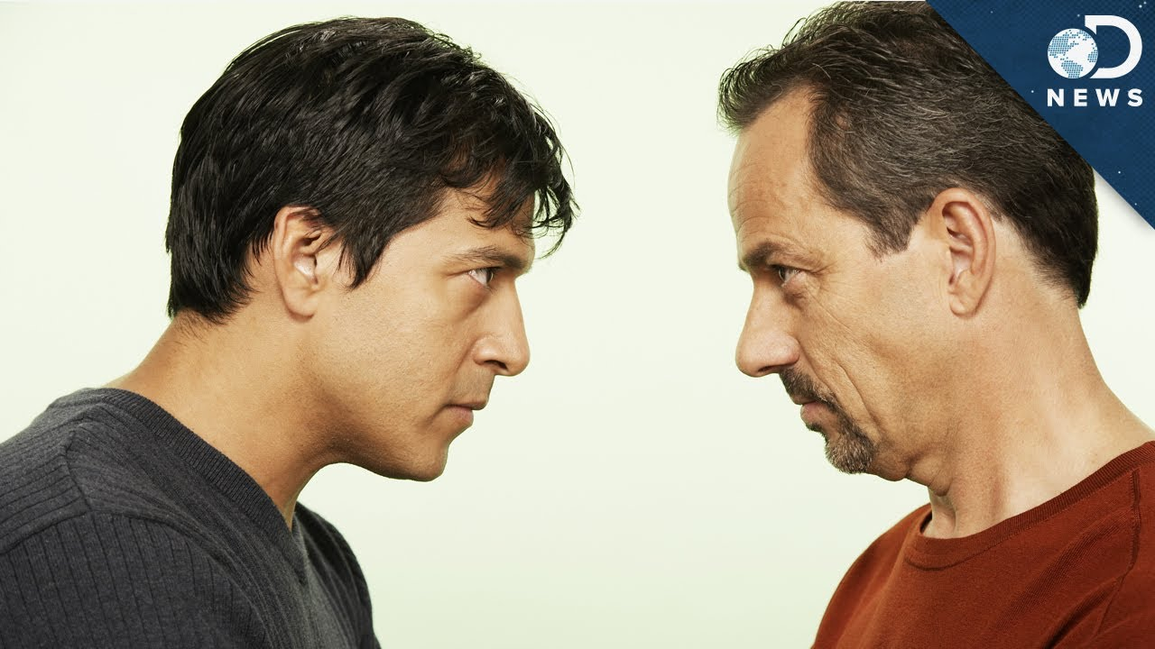


Slide 14
Distance (Proxemics)
a specific distance between yourself and another person in order to communicate a message and to feel comfortable

Slide 15
Categories
Intimate space – 1.5ft around someone, where a partner might stand without making the person feel uncomfortable
Personal space – 4ft around someone, where a friend might stand but not a stranger
Social space – 9ft around someone where strangers stand without being ‘too close for comfort’
Public space - you would stand away from people, if perhaps giving a speech

Slide 16

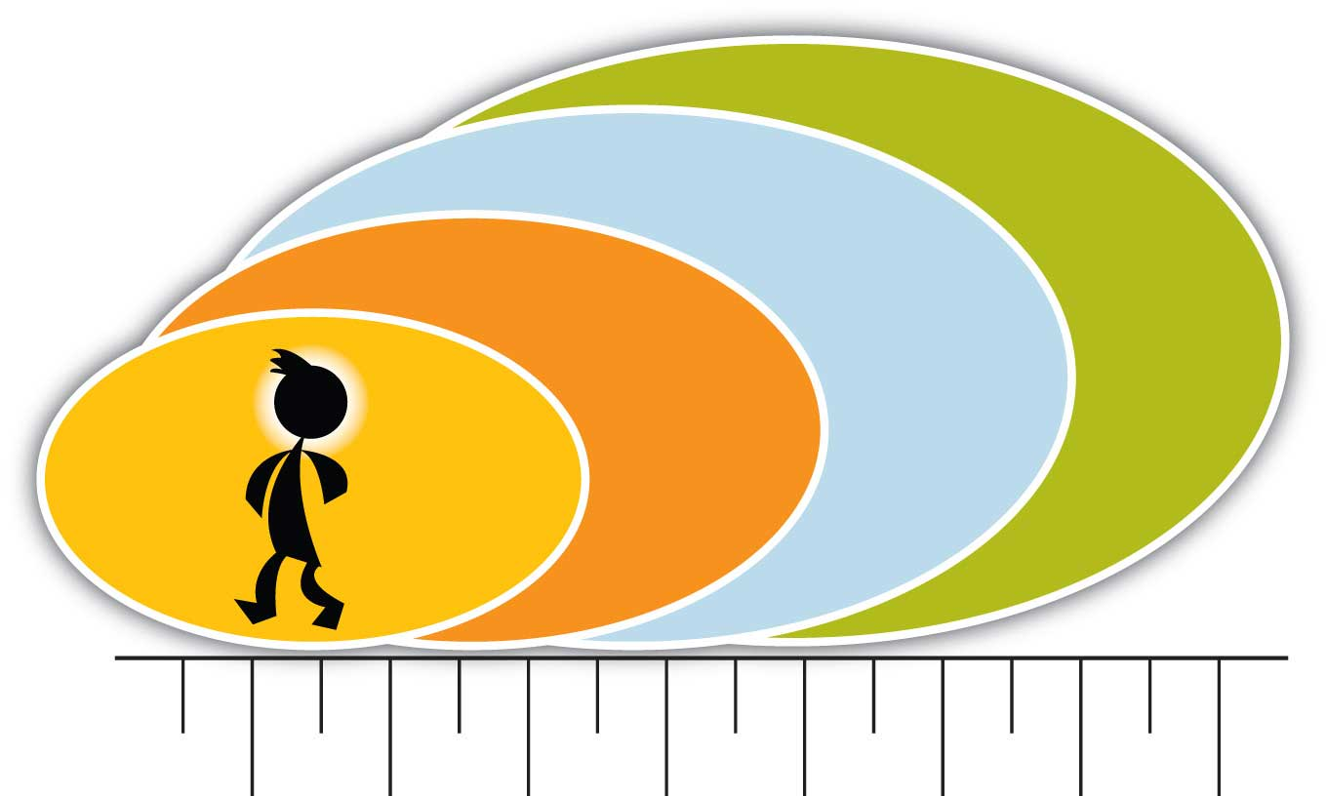

Slide 17
Public Space
Least personal
Sign of power as well as safety -politicians, public figures etc

Slide 18
Social Space
Professional or casual interaction
Keep someone at an arm’s distance

Slide 19
Personal Space
Reserved for friends, acquaintance and social others
extends from 1.5 feet to 4 feet away from our body
2 sub-zones:
outer-personal zone extends from 2.5 feet to 4 feet and is useful for conversations that need to be private but that occur between people who are not interpersonally close
inner-personal zone extends from 1.5 feet to 2.5 feet and is a space reserved for communication with people we are interpersonally close to or trying to get to knowe

Slide 20
Intimate Space
Enter the line inside 1.5 ft
reserved for only the closest friends, family, and romantic/intimate partners
It is impossible to completely ignore people when they are in this space, even if we are trying to pretend that we’re ignoring them.
A breach of this space can be comforting in some contexts and annoying or frightening in others.

Slide 21
Territoriality
Territoriality is an innate drive to take up and defend spaces.
Claim certain places as our own
There are three main divisions for territory: primary, secondary, and public (Hargie, 2011).
Primary: house, yard
Secondary: don’t belong to us and aren’t exclusively under our control, but they are associated with us - classroom desk
Public: are open to all people - People are allowed to mark public territory and use it for a limited period of time, but space is often up for grabs

Slide 22
Non-Verbal Communication in Different Contexts.
Work Environment:
Non-verbal communication plays a crucial role in the workplace, influencing professional interactions, team dynamics, and organizational culture.
It includes cues such as body language during meetings, hand gestures during presentations, and facial expressions during negotiations.
Social Settings:
In social settings such as parties, gatherings, and networking events, non-verbal cues help individuals navigate social interactions, establish rapport, and convey social status.
Examples include eye contact, smiling, and mirroring gestures.

Slide 23
Non-Verbal Communication in Different Contexts.
Romantic Relationships:
Non-verbal communication is essential in romantic relationships, influencing attraction, intimacy, and communication between partners.
Non-verbal cues such as physical touch, eye contact, and facial expressions convey affection, interest, and emotional connection.
Public Speaking:
Effective non-verbal communication is critical for public speakers to engage and persuade their audience.
Body language, gestures, vocal tone, and facial expressions enhance the speaker's credibility, charisma, and persuasive impact.

Slide 24
Non-Verbal Communication and Deception
Signs of Deception:
Certain non-verbal cues, such as avoiding eye contact, fidgeting, and inconsistencies between verbal and non-verbal behavior, can indicate deception or dishonesty.

Slide 25
Non-Verbal Communication and Deception
Detecting Lies through Non-Verbal Cues:
Professionals in fields such as law enforcement and psychology use non-verbal cues to detect lies and deception. Micro expressions, changes in vocal tone, and physiological indicators can reveal concealed emotions or dishonesty.

Slide 26
Non-Verbal Communication and Deception
Importance in Law Enforcement and Psychology:
Non-verbal communication is crucial in interrogations, interviews, and forensic investigations. Detecting deception accurately can aid in criminal investigations, intelligence gathering, and assessing credibility in legal proceedings.

Slide 27
Non-Verbal Communication in Digital Communication
Emoticons and Emoji:
In digital communication platforms such as messaging apps and social media, emoticons and emoji serve as substitutes for non-verbal cues, conveying emotions, tone, and context. However, their interpretation may vary depending on cultural norms and individual preferences.

Slide 28
Non-Verbal Communication in Digital Communication
Use of GIFs and Memes:
GIFs and memes add visual humor and expression to online conversations, enhancing engagement and conveying non-verbal cues such as humor, sarcasm, or excitement.

Slide 29
Non-Verbal Communication in Digital Communication
Challenges and Limitations in Conveying Non-Verbal Cues Digitally:
Despite their popularity, digital communication tools have limitations in conveying nuanced non-verbal cues such as tone of voice, body language, and facial expressions. Misinterpretations and misunderstandings may occur due to the absence of real-time feedback and contextual cues.

Slide 30
Importance of Non-Verbal Communication in Leadership
Impact on Leadership Presence:
Non-verbal communication significantly influences leadership presence and credibility. Leaders who display confident body language, strong eye contact, and assertive posture command respect and inspire confidence among their followers.

Slide 31
Importance of Non-Verbal Communication in Leadership
Building Trust and Rapport:
Effective non-verbal communication fosters trust, rapport, and positive relationships between leaders and their team members. Non-verbal cues such as active listening, empathy, and authenticity build connections and strengthen team cohesion.

Slide 32
Importance of Non-Verbal Communication in Leadership
Effective Use in Influencing Others:
Leaders leverage non-verbal communication techniques to influence, persuade, and motivate others. Charismatic leaders use gestures, vocal tone, and facial expressions to inspire action, convey vision, and drive organizational success.

Slide 33
Gender Differences in Non-Verbal Communication
Variations in Body Language:
Research suggests that men and women may exhibit differences in body language and gestures influenced by societal norms, cultural expectations, and individual differences. Understanding these variations can improve communication and reduce misinterpretations.

Slide 34
Gender Differences in Non-Verbal Communication
Differences in Facial Expressions:
While basic emotions are universally recognized, studies have shown subtle differences in the intensity and frequency of facial expressions between genders. Cultural influences and socialization play a significant role in shaping facial expression patterns.

Slide 35
Gender Differences in Non-Verbal Communication
Cultural Influences on Gendered Non-Verbal Communication:
Cultural norms and expectations regarding gender roles and behavior influence non-verbal communication styles. Awareness of these cultural differences helps individuals navigate cross-cultural interactions and avoid stereotypes or biases.

Slide 36
Non-Verbal Communication and Emotional Intelligence
Recognizing and Understanding Emotions:
Emotional intelligence encompasses the ability to recognize, understand, and manage one's own emotions and those of others. Non-verbal cues such as facial expressions, body language, and tone of voice provide valuable insights into emotional states and intentions.

Slide 37
Non-Verbal Communication and Emotional Intelligence
Regulating Emotional Responses:
Effective non-verbal communication skills enable individuals to regulate their emotional responses and communicate constructively in challenging situations. Techniques such as active listening, empathy, and self-awareness enhance emotional regulation and interpersonal effectiveness.

Slide 38
Non-Verbal Communication and Emotional Intelligence
Enhancing Interpersonal Relationships:
Strong non-verbal communication skills foster empathy, trust, and connection in interpersonal relationships. By accurately interpreting and responding to non-verbal cues, individuals can strengthen their relationships, resolve conflicts, and build supportive networks.

Slide 39
Links of videos
https://www.youtube.com/watch?v=OvEci5Bjgd4
https://www.youtube.com/watch?v=38y_1EWIE9I&list=PLcX7TDig6sB5VduGjsgXeyNzZhPbmQDso
https://www.youtube.com/watch?v=W3P3rT0j2gQ
https://www.youtube.com/watch?v=VRJzvJ5XPQI
https://www.youtube.com/watch?v=OvEci5Bjgd4&t=57s

Slide 40
THANK YOU!

